Slide 1
Chat, Tap, Scan, Pay, and Repeat: WeChat Pay’s Continuous Usage Intention Through the S-O-R Model
MUSTAFA CAN ÇALIŞKAN, 504251544
BLG 640E - Security in Financial Information Systems
Yang Tian, Tak Jie Chan, Tze Wei Liew, Ming Hui Chen, Huan Na Liu, Human Behavior and Emerging Technologies, 2025
Notes:
“Hello everyone. Today I will present a paper called Chat, Tap, Scan, Pay, and Repeat: WeChat Pay’s Continuous Usage Intention Through the S-O-R Model. The paper studies why people keep using a social-media-based payment system over time. I chose to present it from both a user behavior and a security perspective, because in financial information systems, long-term usage depends not only on convenience, but also on trust, privacy, and risk perception. In this talk, I will explain the problem, the research model, the main findings, and the paper’s strengths and limitations.”

Slide 2
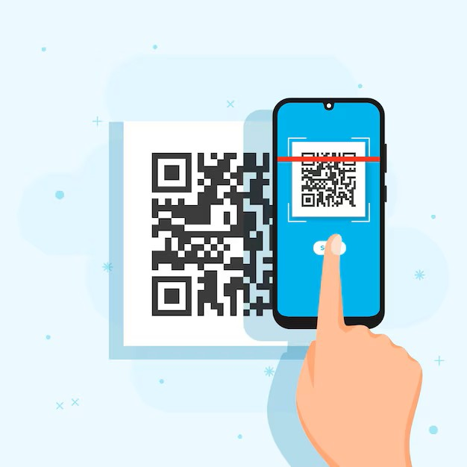
WHY IS THIS TOPIC IMPORTANT?
Mobile payments are now part of daily financial life
Super-apps combine messaging, commerce, and payment
Continued use depends on trust, value, and perceived risk
This topic is important for both business and security
Stock photo source: https://www.freepik.com/free-vector/illustrated-person-scanning-qr-code-with-smartphone_9457132.htm
Notes:
“This topic matters because mobile payment is no longer a niche technology. It is part of everyday financial life. Platforms like WeChat are especially interesting because they are not only payment tools. They are also communication and social platforms. This is why people often call them ‘super-apps,’ meaning one app that combines many services. From a security perspective, continuous use is very important. A user may try a system once, but staying with it is harder. Continued use usually depends on whether users feel value, trust the system, and believe their information is protected.”

Slide 3
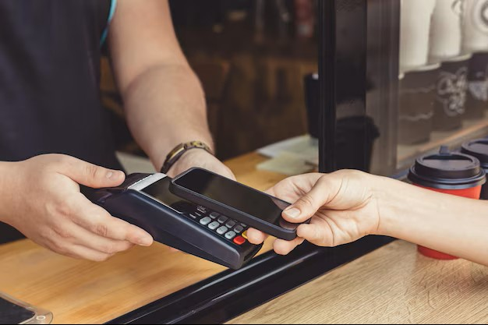
WHY WeChat PAY? WHY MALAYSIA?
WeChat is a social platform with an integrated payment function
The study focuses on Malaysian WeChat Pay users
The case is interesting because WeChat Pay became less prominent in Malaysia
The paper asks: what drives continued use in this context?
Stock photo source: https://www.freepik.com/premium-photo/person-pays-purchase-using-smartphone-through-payment-terminal-street-cafe_22235271.htm
Notes:
“WeChat Pay is an interesting case because it is built into a social platform. Users do not only pay; they also chat, connect, and interact inside the same ecosystem. The paper focuses on Malaysian consumers, which makes the study more specific and easier to discuss. The context is also unusual because WeChat Pay was becoming less prominent in Malaysia. So the key question is not only why people adopt the system, but why they want to keep using it. This difference is important. ‘Continuance intention’ simply means the intention to continue using a system in the future.”

Slide 4
STATE OF THE ART
Earlier studies mainly examined usefulness, convenience, and ease of use
Functional benefits were studied more than social benefits
Risk was discussed, but often in a limited way
Less attention was given to social-payment platforms and post-adoption behavior
Notes:
“When we look at earlier studies, we see a clear pattern. Most research on mobile payment focused on practical benefits such as convenience, usefulness, speed, and ease of use. These are important, but they do not explain the whole picture. In social-payment systems, users may also care about social benefits, such as feeling connected, approved, or supported by others. The paper argues that this side has received less attention. It also says that many studies focus on first-time adoption, while continued use after adoption is still not fully understood.”

Slide 5
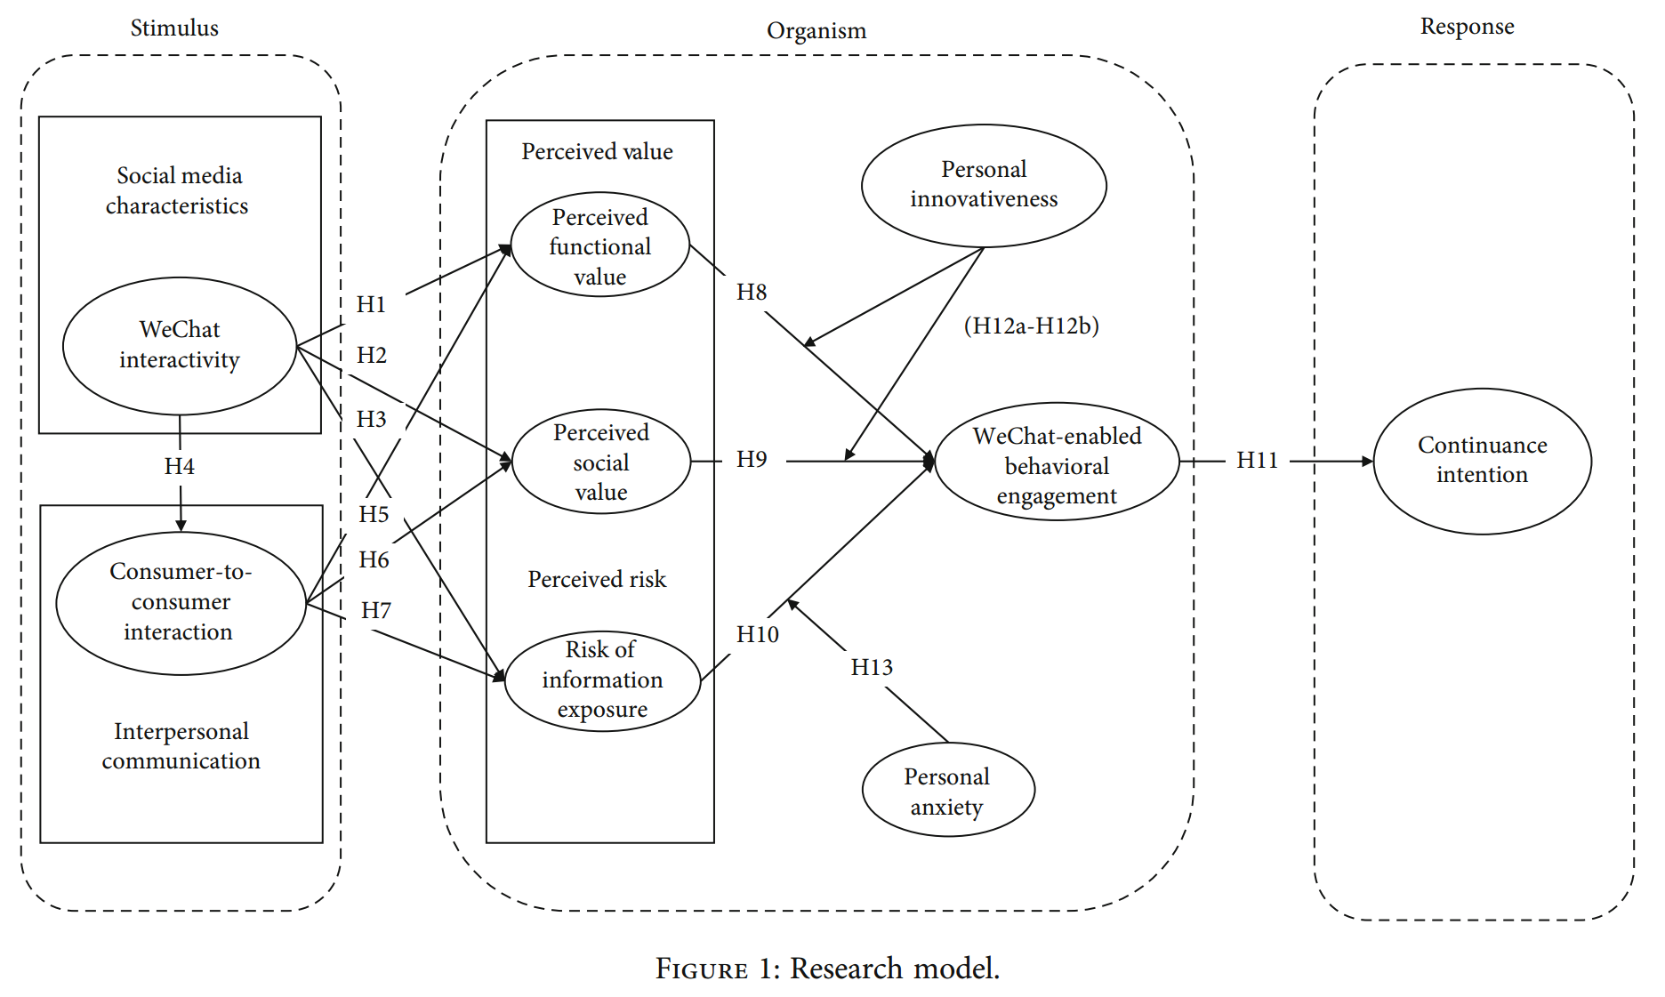
THEORETICAL LENS: S-O-R MODEL
Stimulus = external factors from the environment
Organism = internal evaluations and psychological states
Response = resulting behavior
The model explains how platform features shape user behavior
Notes:
“The paper is based on the S-O-R model, which stands for Stimulus, Organism, and Response. This model is simple but useful. ‘Stimulus’ means external factors, such as platform features or interactions. ‘Organism’ refers to the user’s internal state, like evaluation, feelings, or perception. ‘Response’ is the final behavior. In this study, the idea is that features of WeChat and user interactions affect how people think and feel, and these internal reactions then influence whether they continue using WeChat Pay. So the model gives us a structured way to explain user behavior.”

Slide 6
RESEARCH MODEL
Interactivity and user interaction are the main stimuli
Functional value, social value, risk, and engagement are the internal mechanisms
Continuance intention is the final outcome
Innovativeness and anxiety are tested as moderators
Notes:
“This figure shows the full research model. On the left side, we see the main stimuli: WeChat interactivity and consumer-to-consumer interaction. Interactivity means how well the platform supports communication and real-time exchange. Consumer-to-consumer interaction means users interacting with each other. In the middle, we see the internal factors: perceived functional value, perceived social value, risk of information exposure, and behavioral engagement. On the right side, the final response is continuance intention. The paper also tests two moderators, personal innovativeness and personal anxiety. A moderator is a variable that can change the strength of another relationship.”

Slide 7

METHODOLOGY
Quantitative cross-sectional survey
407 usable responses
Malaysian WeChat Pay users
Analysis with PLS-SEM and moderation testing
Stock photo source: https://www.vecteezy.com/photo/70627498-online-survey-on-laptop-businessman-completing-digital-questionnaire-for-data-analysis-and-customer-feedback
Notes:
“To test the model, the authors used a quantitative survey. They collected data from 407 Malaysian consumers who had experience with WeChat Pay. The study is cross-sectional, which means the data was collected at one period of time, not over several years. For the analysis, the authors used PLS-SEM. This is a statistical method that allows researchers to test many relationships in one model at the same time. They also used moderation testing to see whether innovativeness and anxiety change the main relationships in the model.”

Slide 8
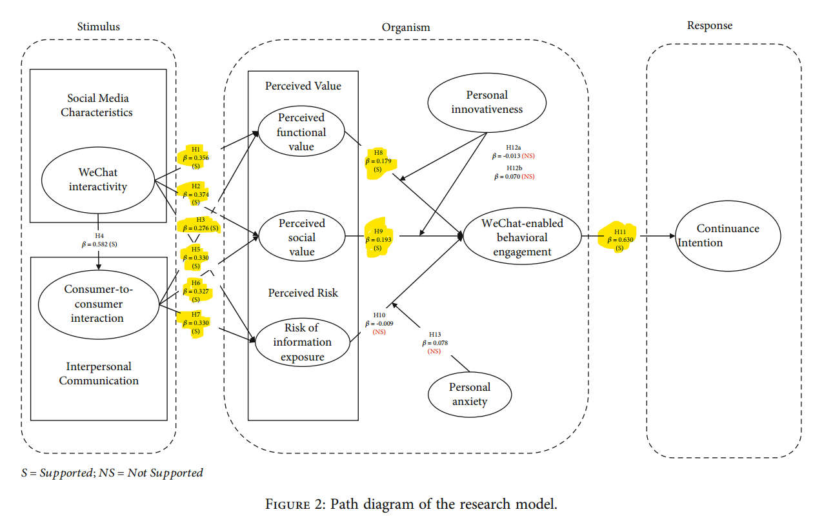
MAIN FINDINGS
Interactivity increased functional value and social value
Consumer-to-consumer interaction also increased both values
Functional value and social value increased behavioral engagement
Behavioral engagement strongly increased continuance intention
Notes:
“As we can see in this figure, the model should be read from left to right, from stimulus to organism to response. On the left side, the two main stimuli are WeChat interactivity and consumer-to-consumer interaction. In the middle, we see the internal factors, especially perceived functional value, perceived social value, and behavioral engagement. On the right side, the final outcome is continuance intention.
The highlighted supported paths show the main story of the paper. First, WeChat interactivity positively affects both perceived functional value and perceived social value. This means that when the platform feels more interactive, users see more practical and social benefits in it. Second, consumer-to-consumer interaction also positively affects these two value dimensions. So, communication between users adds both useful value and social value.
Then, if we move one step to the right, we see that both functional value and social value significantly increase WeChat-enabled behavioral engagement. In other words, when users feel that WeChat Pay is useful and socially valuable, they become more actively involved with the platform. Finally, the strongest supported path in the figure is from behavioral engagement to continuance intention. This tells us that engagement is the key mechanism connecting user perceptions to long-term usage.
So overall, this figure shows that the main driver of continued use is not a single feature, but a chain: interactivity leads to value, value leads to engagement, and engagement leads to continuance intention.”

Slide 9
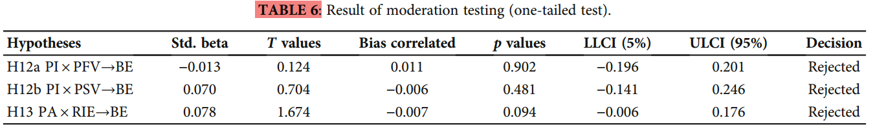
SURPRISING FINDINGS
Information exposure risk did not significantly affect engagement
Personal innovativeness did not significantly moderate the model
Personal anxiety also did not significantly moderate the model
Positive value signals were stronger than the expected risk effect
Notes:
“This table shows the moderation test results. In other words, it asks whether personal traits like innovativeness and anxiety change the strength of the relationships in the model. H12a and H12b test the role of personal innovativeness, and H13 tests the role of personal anxiety.
If we look at the table, we can see that all three hypotheses were rejected. So none of these moderation effects were statistically significant. This means that being more innovative or more anxious did not meaningfully change how value or risk influenced behavioral engagement.
This is surprising, because in financial technology we often expect personal traits to matter more. But here, the data suggests that these traits were not strong enough to change the core pattern of the model.”

Slide 10
CONTRIBUTION OF THE PAPER
Extends the S-O-R model to a social-payment context
Brings social value into continuance-use research
Combines value and risk in one framework
Highlights engagement as the key mechanism
Notes:
“This paper makes several useful contributions. First, it applies the S-O-R model to a social-media payment context, which is more complex than a standard payment app. Second, it gives more attention to social value. This is important because users do not only stay for practical reasons. They may also stay because of connection, approval, and social experience. Third, the paper studies value and risk together in one model. Finally, it shows that engagement is the main mechanism that links user perception to continued use. So the paper adds both theoretical and practical value.”

Slide 11

CHALLENGES AND CRITICAL EVALUATION
The study uses one country and one user group
It is based on self-reported survey data
It measures perceived security risk, not actual technical security
Some reporting around risk paths deserves closer attention
The data was collected before the 2024 discontinuation context discussed in the paper
Stock photo source: https://www.shutterstock.com/search/cyber-security-finance
Notes:
“This slide is important, especially for our class. The paper is useful, but it also has limitations. First, the sample is limited to Malaysian users, so the findings may not generalize everywhere. Second, the study uses self-reported survey data, which means it measures what users say, not what they actually do. Third, the security side is mostly about perceived information exposure risk. This is not the same as real security analysis, such as authentication strength, fraud resistance, or cryptographic protection. Also, there is a point that deserves critical reading: the paper discusses the 2024 discontinuation context, but the survey data was collected earlier, in 2023.”

Slide 12
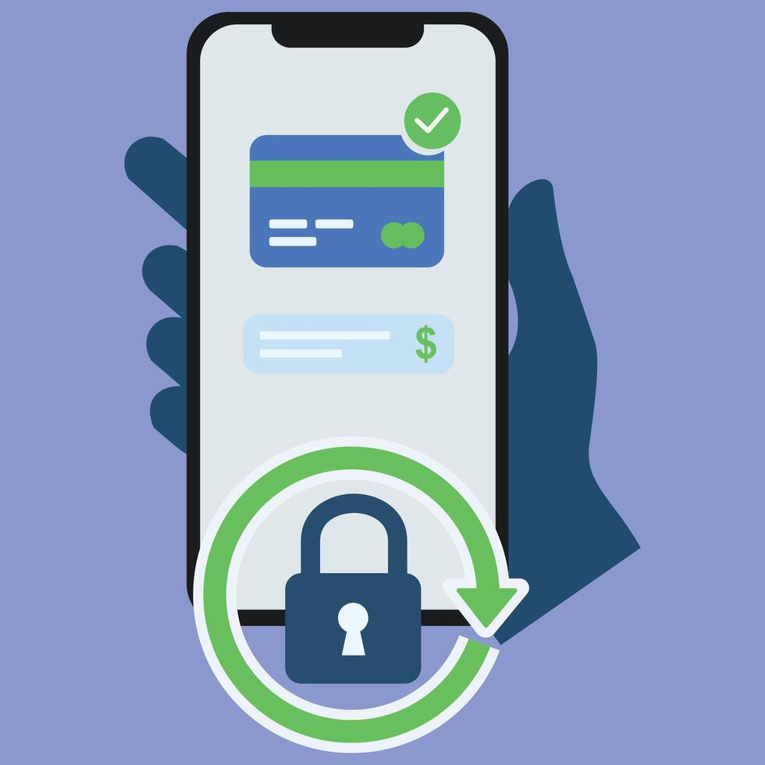
FINAL TAKEAWAYS
Continued use was driven mainly by value and engagement
Social value mattered alongside functional value
Perceived risk was weaker than expected in this study
In financial systems, perceived security and actual security are not the same
Stock photo source: https://www.vecteezy.com/vector-art/73545834-a-hand-holding-a-smartphone-displaying-a-secure-transaction-with-a-credit-card-and-lock-icon-representing-digital-banking-and-online-payments
Notes:
“To conclude, this paper shows that continued use of WeChat Pay was mainly explained by perceived value and behavioral engagement. Both functional value and social value mattered, which means users cared not only about usefulness, but also about social experience. At the same time, perceived information exposure risk was weaker than we might expect. For me, the main lesson for our course is this: in financial information systems, user behavior is shaped by both security perception and platform value. But perceived security and actual security are not always the same, and that difference is very important.”

Slide 13
THANKS FOR LISTENING!

